Slide 1
Roman Empire
27BC to 480

Slide 2
BC
Before Christ
0
Believed birth of Jesus
AD
Anno Domini
BCE
Before Common Era
0
Year Zero
CE
Common Era

Slide 7
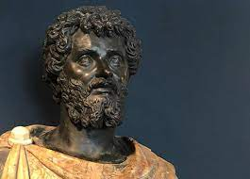

Slide 10
