Slide 1
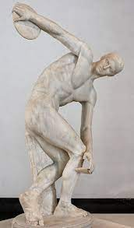
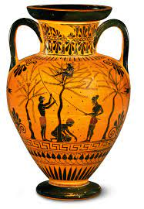
Ancient Greece
800BC to 600AD

Slide 2
Ancient Greece
Way (nearly 1000 years) before the Romans
Roman Empire
During the Romans
A while (a century or so) after the Romans

Slide 10
